Slide 1



China’s Exploration in Data Property Rights System
By Shen Weixing
Tsinghua University, Beijing
2026.9.9
1

Slide 2

Table of Contents
A
Brief Introduction
B
The Structural Separation of Data Property Rights
C
From Property Rights to Facilitating the Transfer of Rights
D
Strengthening Trust Between Parties Through Registration
E
Innovative Features: the Allocation of Rights & Parallel Enjoyment of Rights
F
Summary and Implications
2

Slide 3
A. Brief Introduction
3

Slide 4
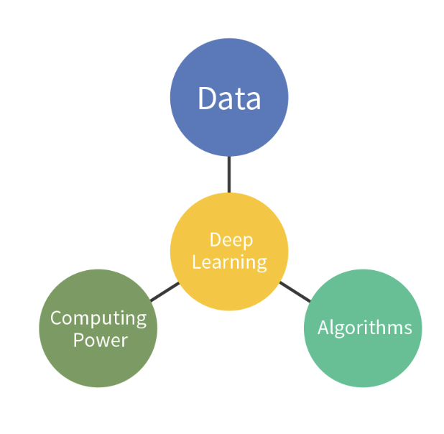
Data and AI are closely connected
Data and AI depend on and reinforce each other.
The development of AI accelerates the process of collecting raw data and processing it into the factor of production.
AI
The development of AI makes the rights structure attached to data increasingly complex.
The development of AI is supported by 3 fundamental elements: (1) computing power; (2) algorithms; (3) and data.
e.g. In typical scenarios of AI, data evolves in form, while the parties involved are often different, resulting in highly complex and intertwined interests.
4

Slide 5


Data and AI are closely connected
Q: Why data caught our attention under the topic of AI economy？
A: If such legal relationships concerning data can’t be properly addressed and regulated at the institutional level, the effective supply of data will be impeded and the development of AI will be undermined.
5

Slide 6
Several Issues Related to Data
The Issues We Need to Consider:
1. How should the contributions of different parties to data be reflected in the establishment and allocation of rights?
2. What activities are allowed to be carried out by a data recipient with the data it obtains?
3. What is the relationship between the parties who hold data property rights?
Mechanisms for Allocating the Interests in Data
Data Property Rights System
the most important issue
6

Slide 7
Different Approaches from Comparative Views
Different countries have adopted different approaches:
EU: It primarily protects the interests of different parties through personal data protection, right to access and data portability, database protection, and specific data sharing obligations.
US: It adopts a decentralized approach, relying on contracts, trade secret protection, tort law, competition law, and industry self-regulatory rules.
China: It has gradually explored the data property rights approach, drawing on the distinctive characteristics of data as a factor of production.
7

Slide 8

The Model of Data Property Rights System
Traditional Framework of Ownership
distinct legal concepts
different characteristics
NEW CONCEPT
SEVERAL FEATURES
Data Property Rights
Systemic Adaptability:
coordination with existing rules
Supporting Measure I
data contracts
Supporting Measure II
data registration
Governance Method:
applying a risk-based approach
8

Slide 9
The Model of Data Property Rights System
Traditional Framework of Ownership
distinct legal concepts
different characteristics
NEW CONCEPT
SEVERAL FEATURES
Data Property Rights
China has chosen the structural separation of data property rights as the starting point.
Systemic Adaptability:
coordination with existing rules
Supporting Measure I
data contracts
Supporting Measure II
data registration
Governance Method:
applying a risk-based approach
9

Slide 10
B. The Structural Separation of Data Property Rights
10

Slide 11
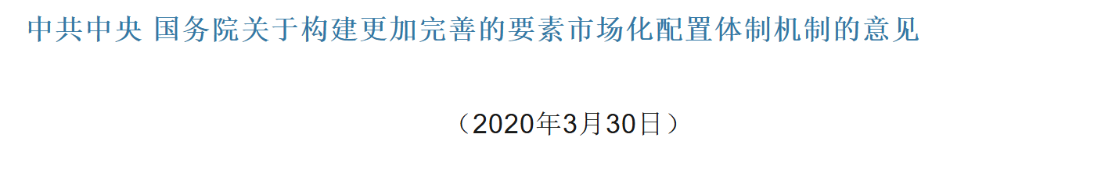
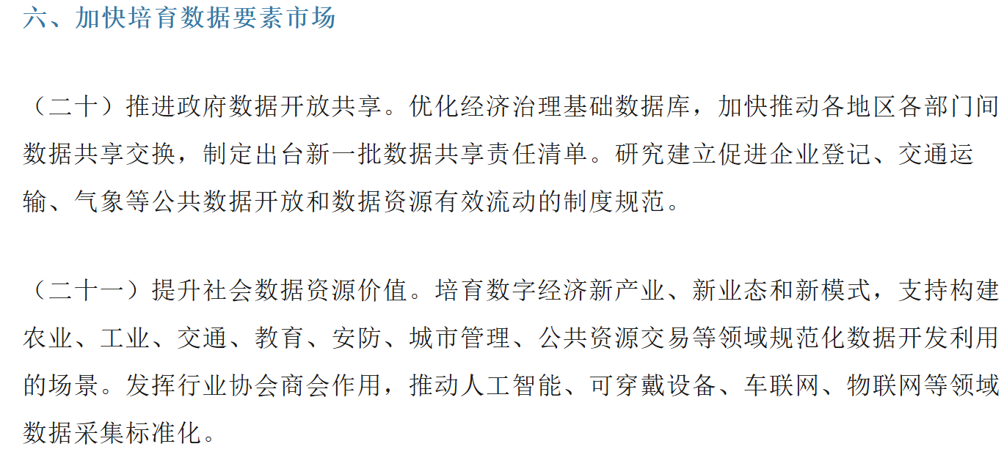

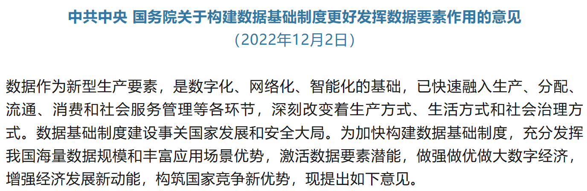
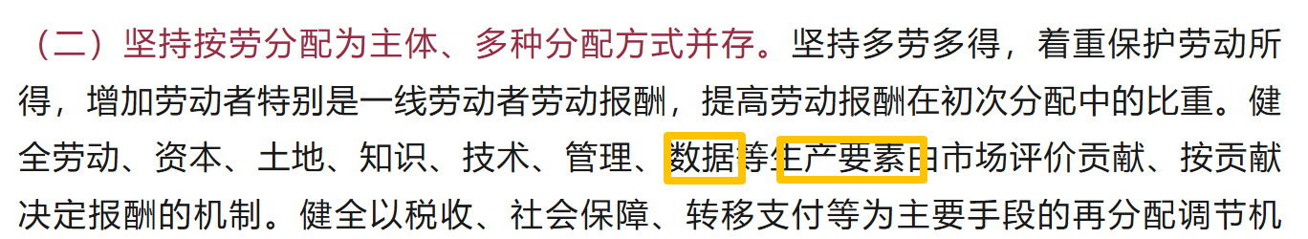
From Data as a Factor of Production to Data Property Rights
Accelerate the development of the data factor market.
The process of market-oriented reform has continued to advance
Data is recognized as a factor of production.
Establish the “three rights separation” framework for data.
the right to hold data resources
the right to process and use data
2022
2020
2019
the right to operate the data products
11

Slide 12
The Logic Behind the Structural Separation of Data Property Rights
* The process through which data is produced and circulated
stage 1: control
stage 2: utilization
stage 3: market-oriented deployment
Data should be capable of being lawfully and stably controlled.
Data could be read, aggregated, analyzed, and modeled for more utilization.
Data could enter the market through transfer, licensing, services, or other forms of transaction
Data Products
the right to hold data resources
the right to process and use data
the right to operate the data products
Data Resources
12

Slide 13
The Change of Terminologies in Three Rights
The National Data Administration changed the terminologies used for three rights in Glossary of Data-related Terms.
replacing: the right to hold data resources ➡ to: the right to hold data
replacing: the right to process and use data ➡ to: the right to use data
replacing: the right to operate the data products ➡ to: the right to operate data
The rationale lies in the renewed understanding of the object of data property rights.
1. it is difficult to draw a clear boundary between data resources and data products；
2.A data product created at an earlier stage of the circulation may become the data resource used as an input for the production at a later stage;
3. Repeatedly changing between data resources and data products will fragment the object of data property rights.
13

Slide 14
The explanation of Three Rights
The Right to Hold Data
* to determine how the data is stored, encrypted, and accessed;
* to protect its control of data from infringement;
* to take the responsibility for data security.
* granting the holder’s autonomous capacity to control data
Three
Rights
The Right to Use Data
* to read, analyze, model, and develop data;
* where processed data becomes substantively different from the original data, property rights may be allocated over the derived data.
* focusing on the utilization of data and further exploitation of its value
The Right to Operate Data
* to promotes the data circulation, utilization, and release of data values.
（it needs to be distinguished from the internal use of data）
*providing data to others
14

Slide 15
Preliminary Discussion on the Features of Structural Separation of Data Property Rights
Feature 1: allocation of rights
Feature 2: parallel enjoyment of rights
The three rights could be freely combined and allocated to different parties.
Multiple parties may hold the same type of right over the same data and won’t interfere with one another.
a: combination of all three rights
party b
party c
e: the right to hold and use data
party a
hold
party d
b: the right to hold data
hold and use
seven combinations
of rights
the same data
f: the right to hold and operate data
hold and use
hold and operate
c: the right to use data
Data property rights have become the modular institutional tools that can be flexibly adjusted (more details in part 4).
d: the right to operate data
g: the right to use and operate data
15

Slide 16
C. From Property Rights to Facilitating the Transfer of Rights
16

Slide 17






The Diverse Forms of Transactions in Practice
operate
operate
use
hold
use
hold
the static framework of rights
the rights are flowed
* Data transactions take many different forms:
Some involve the direct delivery of data to the data recipient.
Some provide access through an API.
Some entrust others to process the data.
Some involve multiple parties jointly investing data and technology for integrated development
Some require intermediaries to match supply and demand and create opportunities.
17

Slide 18
The Darft of Four Model Contracts
* China regulates data transactions through model contracts:
the National Data Administration (NDA) and the State Administration for Market Regulation (SAMR) jointly issued four model contracts:
The data provision contract
The data commission processing contract
The data combining and development contract
The data intermediary contract
18

Slide 19
The Definition of Four Model Contracts
* China regulates data transactions through model contracts:
The data provision contract
The data commission processing contract
The data combining and development contract
The data intermediary contract
It applies where a party provides the data to the another party through transfer, licensing, sharing, or other ways.
It applies where a party entrusts data over which it has lawful rights to another party.
It applies to situations where parties share data over which they have lawful rights for the purpose of jointly creating something.
It applies where an intermediary provides services.
19

Slide 20
The Contents and Considerations of Four Model Contracts
* By extracting the features of typical data transactions, the model contracts contain:
the subject matter
methods of delivery
restrictions on use
allocation of data property rights
obligations of confidentiality
liability for defects
* Two principal considerations underlying the model contracts:
1. standardized contractual clauses fill the gaps in party autonomy, reduce the transaction costs, and serve the function of expectation management.
2. Model contracts serve as a bridge between public regulation and private autonomy.
20

Slide 21
D. Strengthening Trust Between Parties Through Registration
21

Slide 22
The Importance of Trust in Transactions and Difficulties in Its Realization
* A subsequent transferee should verify both the legality of data resources and the transferor’s authority to dispose of the relevant rights.
transfer
transfer
legality？
authority？
legality？
authority？
* The Difficulty of Building Trust in Data Transactions:
1. The sharing of data among multiple parties has gradually become more common than exclusive control over data, making the relationships more complex.
2. The characteristics of data make it more difficult to directly apply the traditional approach of taking possession as the external manifestation of rights.
22

Slide 23
The Damage Caused by Insufficient Trust and the Solution
* The damage caused by insufficient trust:
transfer
transfer
legality？
authority？
legality？
authority？
The raise of costs
The raise of costs
* The solution to it:
transfer
transfer
Through
registration
information that could be easily identified
information that could be easily identified
23

Slide 24
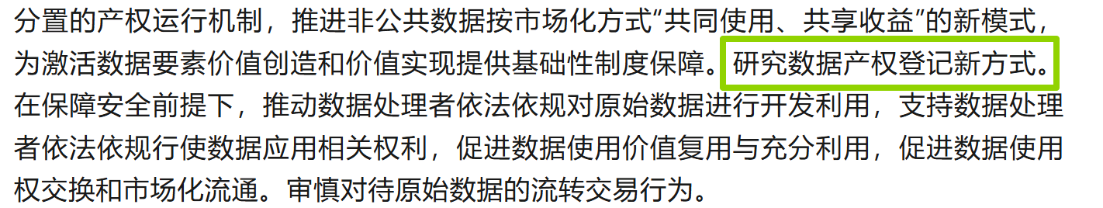
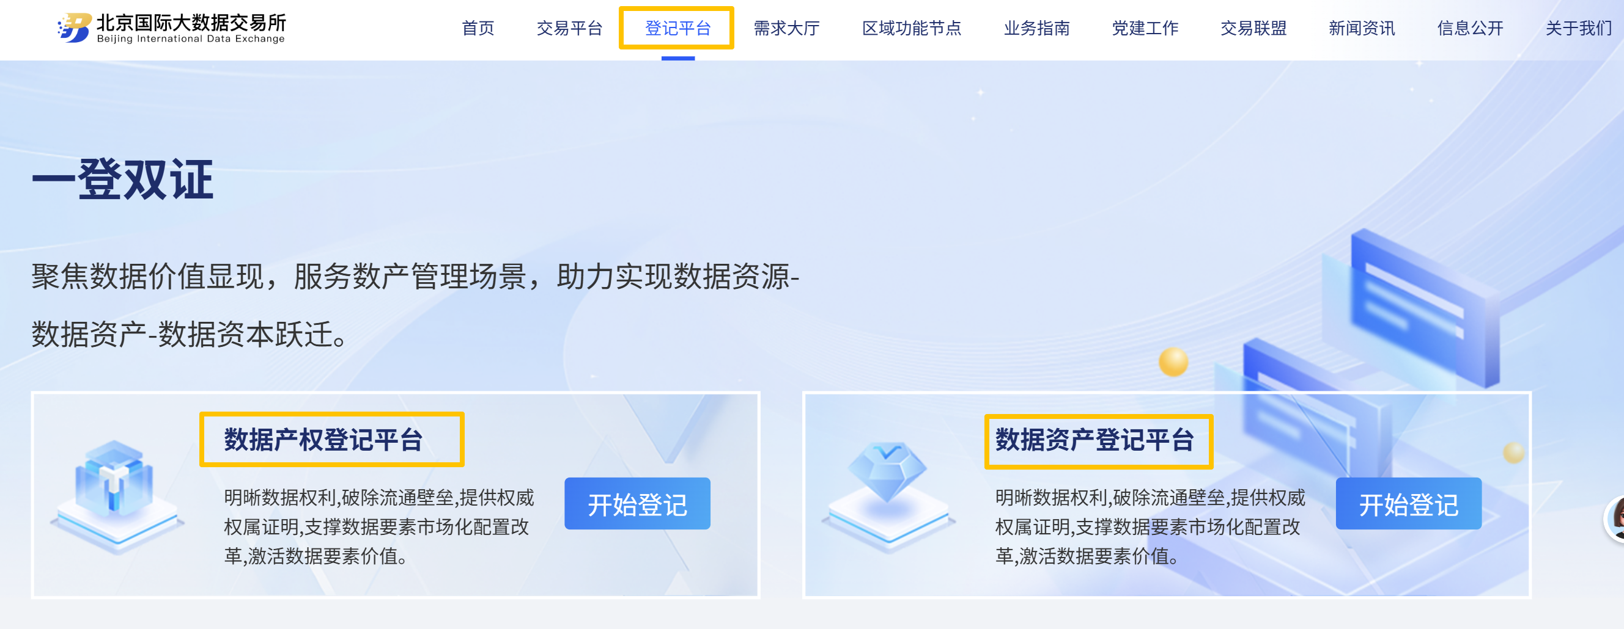
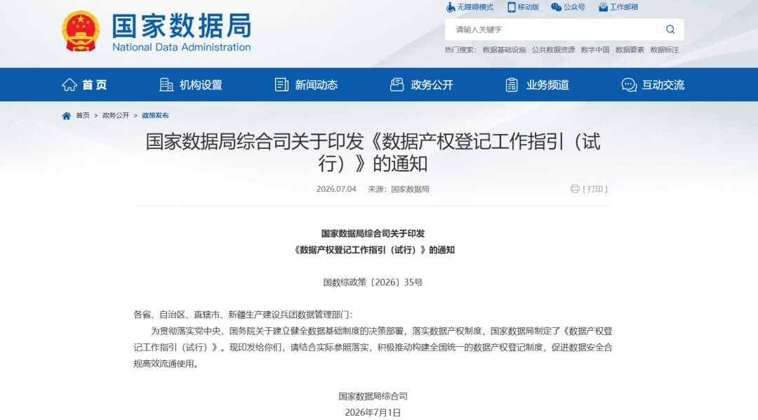
Documents and Practices Related to Resgistration
In 2022, the policy called for research into new methods of data property rights registration.
Guizhou and Shenzhen issued normative documents relating to data property rights or registration.
Data exchanges across China actively implemented the relevant requirements and begun to provide registration services.
In July 2026, a unified framework for data property rights registration is built up.
24

Slide 25
The Rules of Registration
* According to the Trial Guidelines on Data Property Rights Registration:
1. The authorities of registration are required to apply the standard of reasonableness and carefulness.
2. The registration process includes application, acceptance, examination, public notice, handling of objections, information preservation, and the issuance of registration certificates.
3. The types of registration include initial registration, transfer registration, amendment registration, renewal registration, and cancellation registration.
⭐ The renewal registration also responds to the rapid updating of data and the time sensitivity of its value. It helps to prevent the registration from becoming inaccurate or ineffective over the time and turning into what might be described as “zombie registration”.
25

Slide 26
The Benefits of Registration
* The result of registration:
data transactions
data assets capitalization
provide the proof of rights
reduce the information barriers
credit enhancement
dispute resolution
* Both applicants and authorities of registration should take responsibility:
Article 38: The registration authority shall be legally liable for the accuracy of the registration results.
Article 39: Where a registration applicant engages in any of the following acts and causes harm to others, the applicant shall bear civil liability, including liability for damages, in accordance with the law.
26

Slide 27
E. Innovative Features: the Allocation of Rights and Parallel Enjoyment of Rights
27

Slide 28
A Non-Negligible Objective Opinion
* There are two opposing opinions on the issue of the establishment of data property rights:
supporting opinion
objective
opinion
the establishment of data property rights
The objective opinion argues that, as an emerging factor of production in the digital economy, data reflects the characteristics of connection, openness, sharing, and collaborative utilization. Granting the exclusive rights to particular parties may limit the use of data.
28

Slide 29
Response to Objective Opinion
Q: Whether the characteristics of data contradict the establishment of data property rights?
A: No. And there are many reasons for establishing the data property rights: a. the creation of data requires corresponding investment; b. data access and application value may be scarce; c. data embodies exchange values and could be traded in the market.
“There are interests attached to it that need to be allocated and protected!”
29

Slide 30
What Do the Characteristics of Data Really Change
* It turns the issue from Q1 to Q2:
Q1: Whether the data property rights should be established
Q2: How to establish the rights? and what effect does the rights have?
two ways for adjusting the traditional rules
1. three rights could be allocated to different parties to prevent a single form of right from absorbing all data interests
2. the exclusive effect of data property rights could be modified to allow multiple parties to use the same data at the same time.
30

Slide 31
What Do the Characteristics of Data Really Change
* It turns the issue from Q1 to Q2:
Q1: Whether the data property rights should be established
Q2: How to establish the rights? and what effect does the rights have?
two ways for adjusting the traditional rules
1. three rights could be allocated to different parties to prevent a single form of right from absorbing all data interests
2. the exclusive effect of data property rights could be modified to allow multiple parties to use the same data at the same time.
Feature 1:
allocation of rights
Feature 2:
parallel enjoyment of rights
(corresponding to the point discussed in the second part )
31

Slide 32


Feature 1: Allocation of Rights
Definition: allocation of rights refers to the allocation of the rights to hold, use, and operate data among different parties in different combination
Method: allocation of rights is based on the particular data utilization scenarios and ways of use; and following the principle of “ those who invest and contribute should have the related benefits.”
Data is generated by a single party or is fully transferred to another party, three rights will be held by a single party.
In the process of deriving values from data and circulating it across multiple parties, the three rights may be allocated among different parties.
Senario a:
Senario b:
The picture shows how an enterprise generates and uses its own business data.
The picture shows how a user authorize an enterprise to process their personal data.
32

Slide 33

Feature 1: Allocation of Rights
In data production relationships:
collect data independently
multiple parties contribute to collection
In data circulation relationships:
transfer
licensing
33

Slide 34

Feature 1: Allocation of Rights
In data production relationships:
Reminder: The rights to hold, use, and operate data could be combined in different ways.
collect data independently
a: combination of all three rights
multiple parties contribute to collection
e: the right to hold and use data
b: the right to hold data
seven combinations
of rights
In data circulation relationships:
f: the right to hold and operate data
c: the right to use data
d: the right to operate data
g: the right to use and operate data
transfer
licensing
34

Slide 35
Feature 2: Parallel Enjoyment of Rights
Definition: Parallel Enjoyment of Rights means that multiple parties may simultaneously hold the same data and enjoy rights of the same type over the data.
Elements: allocation of rights contains four basic elements: a. there are multiple right holders; b. the object of rights is the same data; c. the multiple right holders enjoy the same type of rights; d. these rights coexist during the same period without excluding one another.
licensing
concurrently enjoy the right to use and process data
licensing
licensing
35

Slide 36
Feature 2: Parallel Enjoyment of Rights
Distinction between similar concepts: Parallel Enjoyment of Rights is also different from the co-ownership. In the relationship of co-ownership, multiple parties jointly hold a single right rather than separate rights of the same type.
Modification of the Effect of Property Rights: allocation of rights constitutes an adjustment to the absolute exclusive effect of traditional property rights. The exclusivity of data property rights is relative rather than absolute.
1.The right holder is entitled to exclude infringing acts;
2. the right holder can’t exclude others from obtaining the same type of rights over the same data through lawful acts.
36

Slide 37
F. Summary and Implications
37

Slide 38
Summary and Implications
China has already developed a comprehensive framework of data property rights covering the establishment of rights, transactions of rights, and the unified registration rules, and it still requires further testing and refinement in practice.
Addressing the governance challenges brought about by data as a factor of production needs exchanges of experiences among different countries and legal systems.
The topics of discussions includes: a. the legal foundations of data property rights; b. the boundaries of data access; c. mechanisms for allocating interests; d. and standards for data use in the age of artificial intelligence.
38

Slide 39

Thanks!
Following our Wechat Official Account
to obtain frontier research updates in computational law！
39

