Slide 1

Centro de Inteligência Artificial e Aprendizado de Máquina

Slide 2

AI Regulatory Sandboxes and the UNESCO Recommendation on the Ethics of Artificial
Joao Pita Costa, lead AI Researcher at IRCAI , advisor at CIAAM/USP
Brazil–China Legal Dialogue on Artificial Intelligence | Building AI Governance: Regulatory Frameworks and Institutional Models in Brazil and China
,
9 September 2026
Notes:
Operationalizing the UNESCO Recommendation on the Ethics of Artificial Intelligence through Sectoral Governance in Brazil
Core message:
AI governance faces a persistent implementation gap:
Global ethical principles
↓
Regulatory frameworks
↓
Practical evaluation of AI systems
↓
Responsible deployment
The question:
How can regulatory sandboxes turn the UNESCO principles into concrete, testable governance requirements?
Speaker emphasis:
“UNESCO provides a global ethical framework, but principles such as human dignity, transparency and accountability only become meaningful when regulators can actually evaluate whether an AI system meets them.”

Slide 3
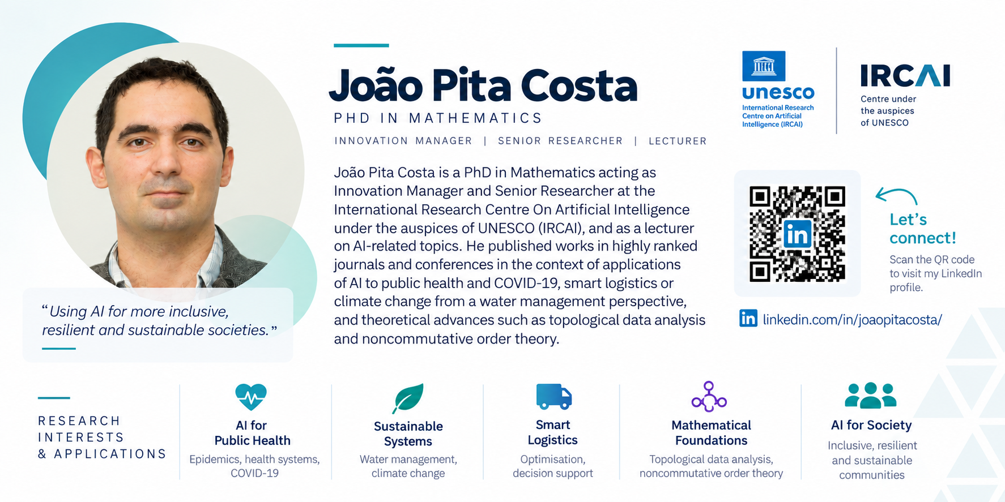

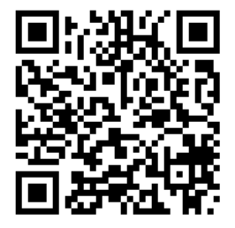
Key Highlights of the Research

Slide 4
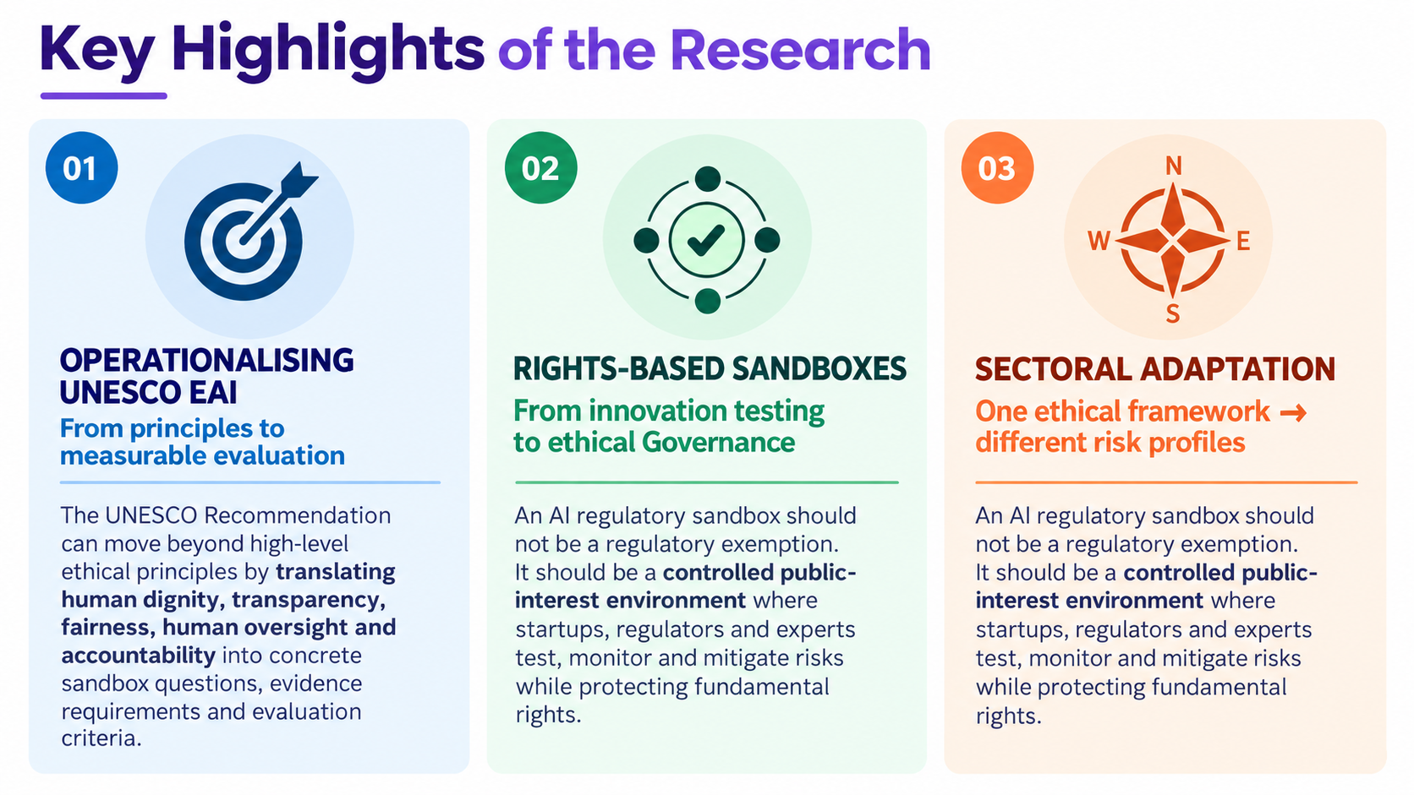


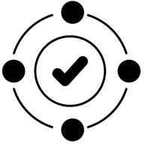
Key Highlights of the Research
OPERATIONALISING UNESCO EAI, From principles to measurable evaluation. The UNESCO Recommendation can move beyond high-level ethical principles by translating human dignity, transparency, fairness, human oversight and accountability into concrete sandbox questions, evidence requirements and evaluation criteria.
RIGHTS-BASED SANDBOXES, From innovation testing to ethical Governance. An AI regulatory sandbox should not be a regulatory exemption. It should be a controlled public-interest environment where startups, regulators and experts test, monitor and mitigate risks while protecting fundamental rights.
SECTORAL ADAPTATION, One ethical framework → different risk profiles. An AI regulatory sandbox should not be a regulatory exemption. It should be a controlled public-interest environment where startups, regulators and experts test, monitor and mitigate risks while protecting fundamental rights.

Slide 5
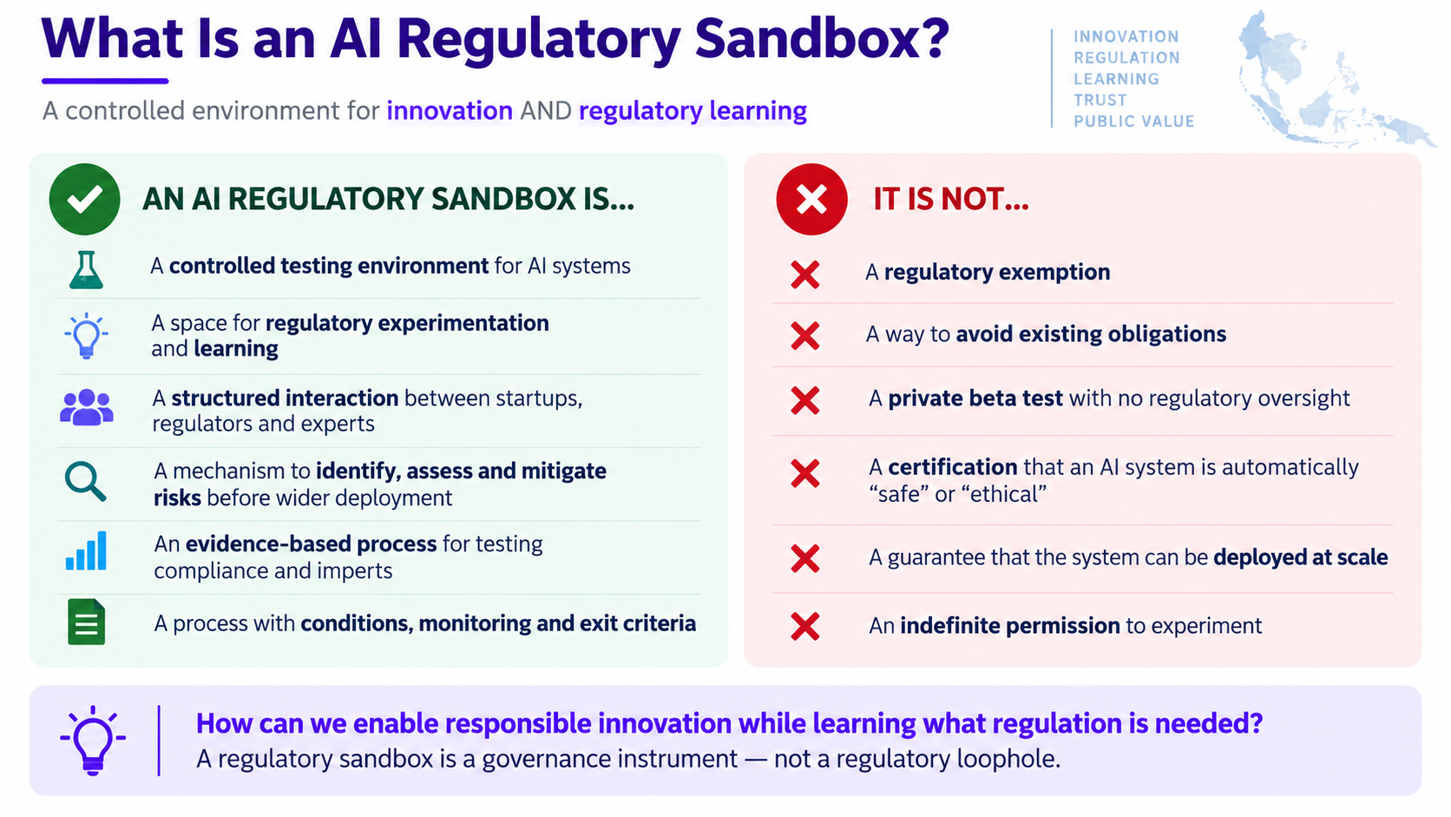
What Is an AI Regulatory Sandbox?
A controlled environment for innovation AND regulatory learning
AN AI REGULATORY SANDBOX IS… | IT IS NOT…
🧪 A controlled testing environment for AI systems | ❌ A regulatory exemption
⚖️ A space for regulatory experimentation and learning | ❌ A way to avoid existing obligations
👥 A structured interaction between startups, regulators and experts | ❌ A private beta test with no regulatory oversight
🔍 A mechanism to identify, assess and mitigate risks before wider deployment | ❌ A certification that an AI system is automatically “safe” or “ethical”
📊 An evidence-based process for testing compliance and impacts | ❌ A guarantee that the system can be deployed at scale
🚪 A process with conditions, monitoring and exit criteria | ❌ An indefinite permission to experiment
How can we enable responsible innovation while learning what regulation is needed?
A regulatory sandbox is a governance instrument — not a regulatory loophole.
Notes:
This distinction is fundamental. A sandbox is not simply a place where a startup tests its product. It is a controlled regulatory environment in which the regulator also learns. The company gets an opportunity to experiment under defined conditions, but in return it has stronger obligations around transparency, evidence, risk mitigation and reporting. And importantly, participation in the sandbox does not mean that the system is certified as ethical or automatically authorised for wider deployment.

Slide 6
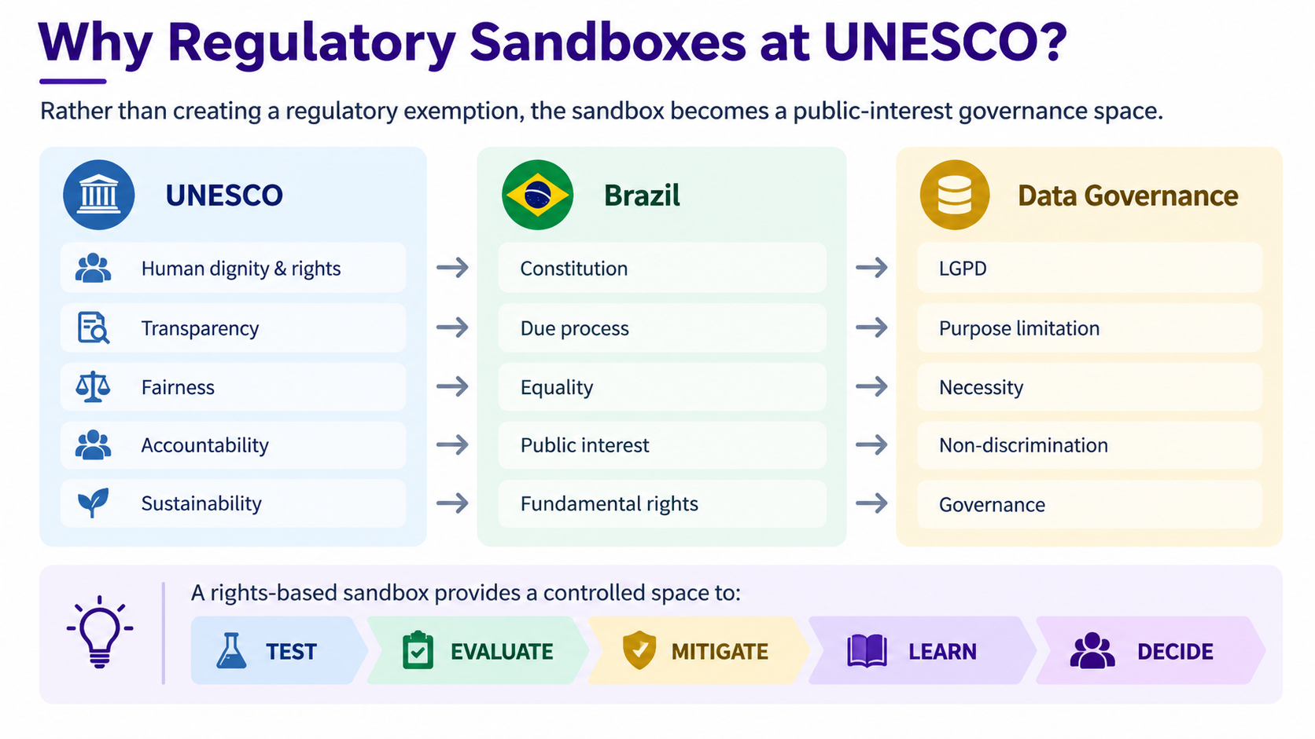
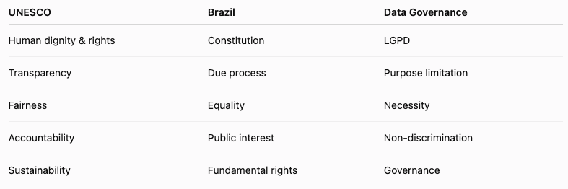
Why Regulatory Sandboxes at UNESCO?
Rather than creating a regulatory exemption, the sandbox becomes a public-interest governance space.
A rights-based sandbox provides a controlled space to:
TEST → EVALUATE → MITIGATE → LEARN → DECIDE

Slide 7
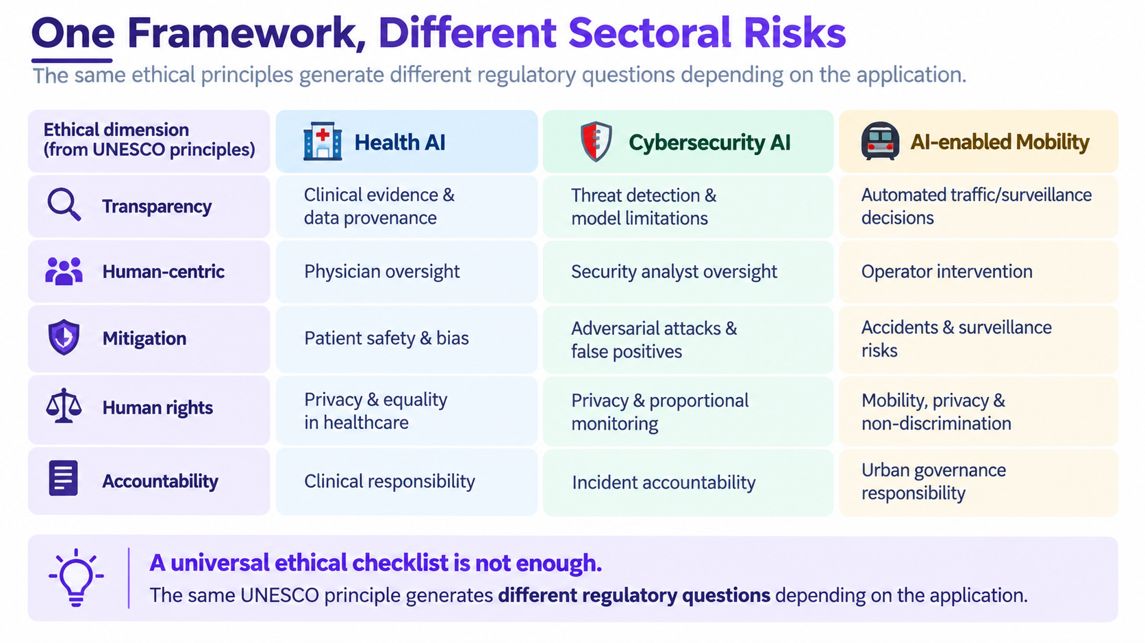
One Framework, Different Sectoral Risks
 | 🏥 Health AI | 🛡 Cybersecurity AI | 🚇 AI-enabled Mobility
Transparency | Clinical evidence & data provenance | Threat detection & model limitations | Automated traffic/surveillance decisions
Human-centric | Physician oversight | Security analyst oversight | Operator intervention
Mitigation | Patient safety & bias | Adversarial attacks & false positives | Accidents & surveillance risks
Human rights | Privacy & equality in healthcare | Privacy & proportional monitoring | Mobility, privacy & non-discrimination
Accountability | Clinical responsibility | Incident accountability | Urban governance responsibility
A universal ethical checklist is not enough
The same UNESCO principle generates different regulatory questions depending on the application.

Slide 8
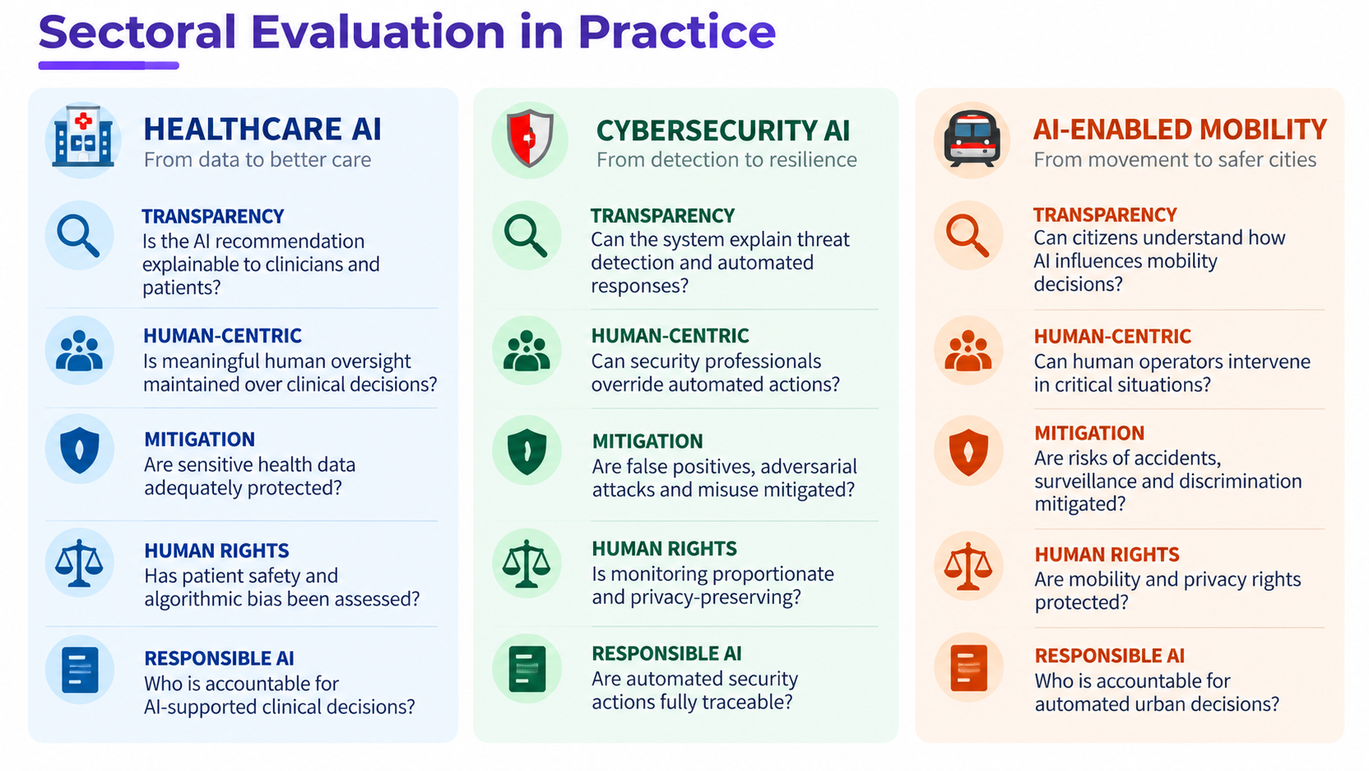
Sectoral Evaluation in Practice
🏥 HEALTHCARE AI
🛡 CYBERSECURITY AI
🚇 AI-ENABLED MOBILITY
TRANSPARENCY
TRANSPARENCY
TRANSPARENCY
Is the AI recommendation explainable to clinicians and patients?
Can the system explain threat detection and automated responses?
Can citizens understand how AI influences mobility decisions?
HUMAN-CENTRIC
HUMAN-CENTRIC
HUMAN-CENTRIC
Is meaningful human oversight maintained over clinical decisions?
Can security professionals override automated actions?
Can human operators intervene in critical situations?
MITIGATION
MITIGATION
MITIGATION
Are sensitive health data adequately protected?
Are false positives, adversarial attacks and misuse mitigated?
Are risks of accidents, surveillance and discrimination mitigated?
HUMAN RIGHTS
HUMAN RIGHTS
HUMAN RIGHTS
Has patient safety and algorithmic bias been assessed?
Is monitoring proportionate and privacy-preserving?
Are mobility and privacy rights protected?
RESPONSIBLE AI
RESPONSIBLE AI
RESPONSIBLE AI
Who is accountable for AI-supported clinical decisions?
Are automated security actions fully traceable?
Who is accountable for automated urban decisions?
Notes:
Speaker emphasis:
“This is where the sandbox becomes particularly valuable: startups are not simply asked whether they are ‘ethical’; they are required to demonstrate how ethical principles translate into operational safeguards.”

Slide 9
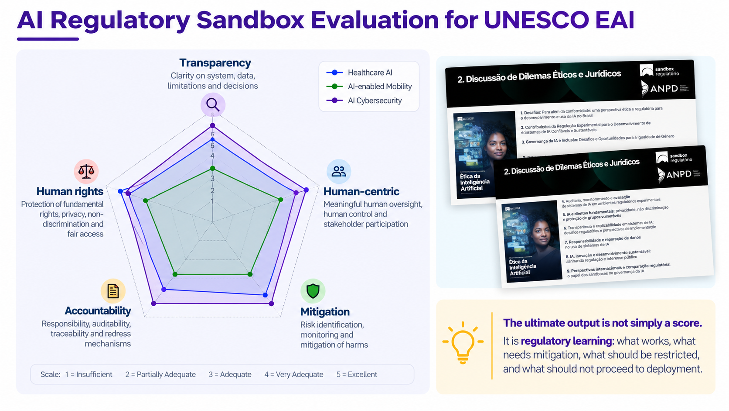
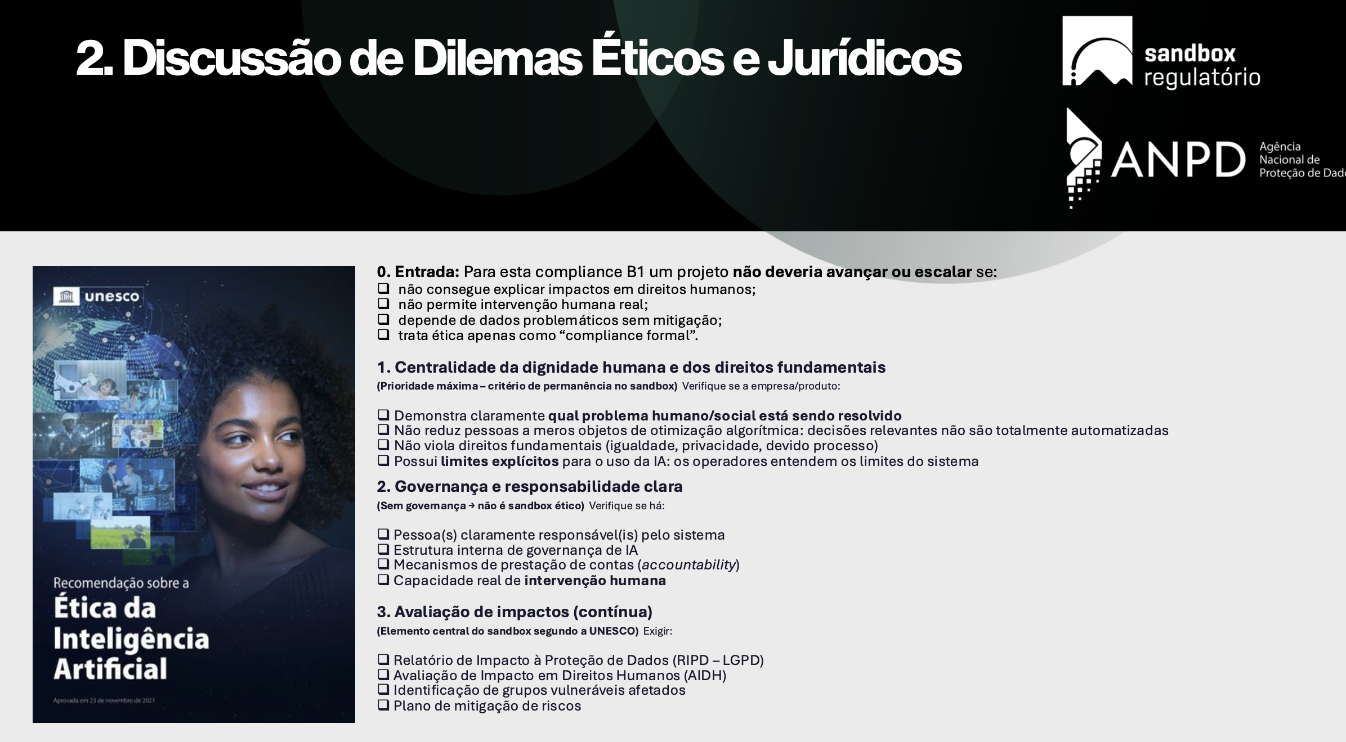
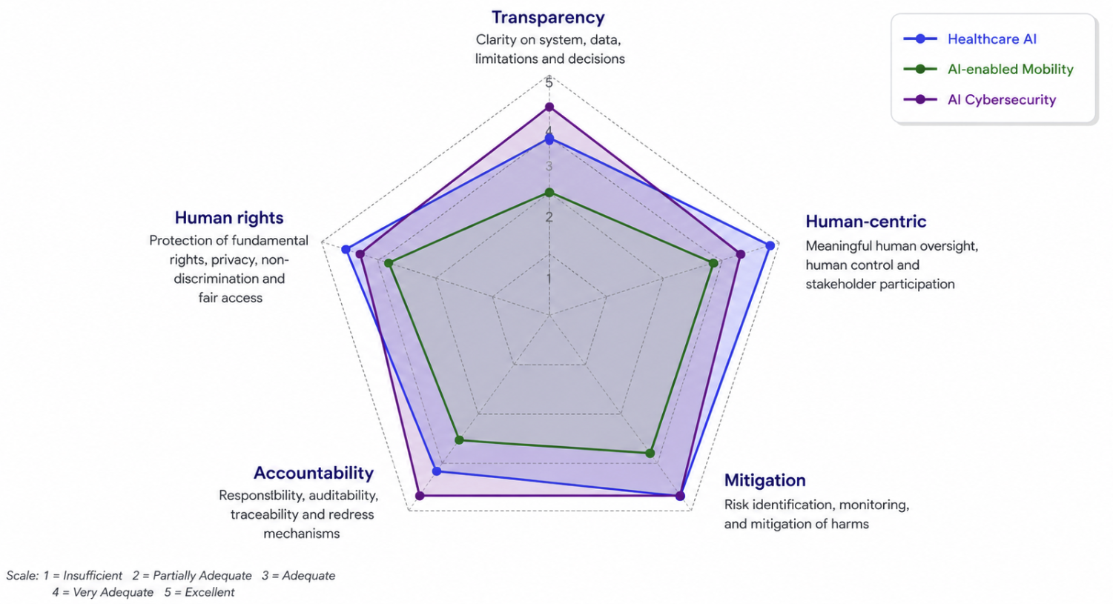
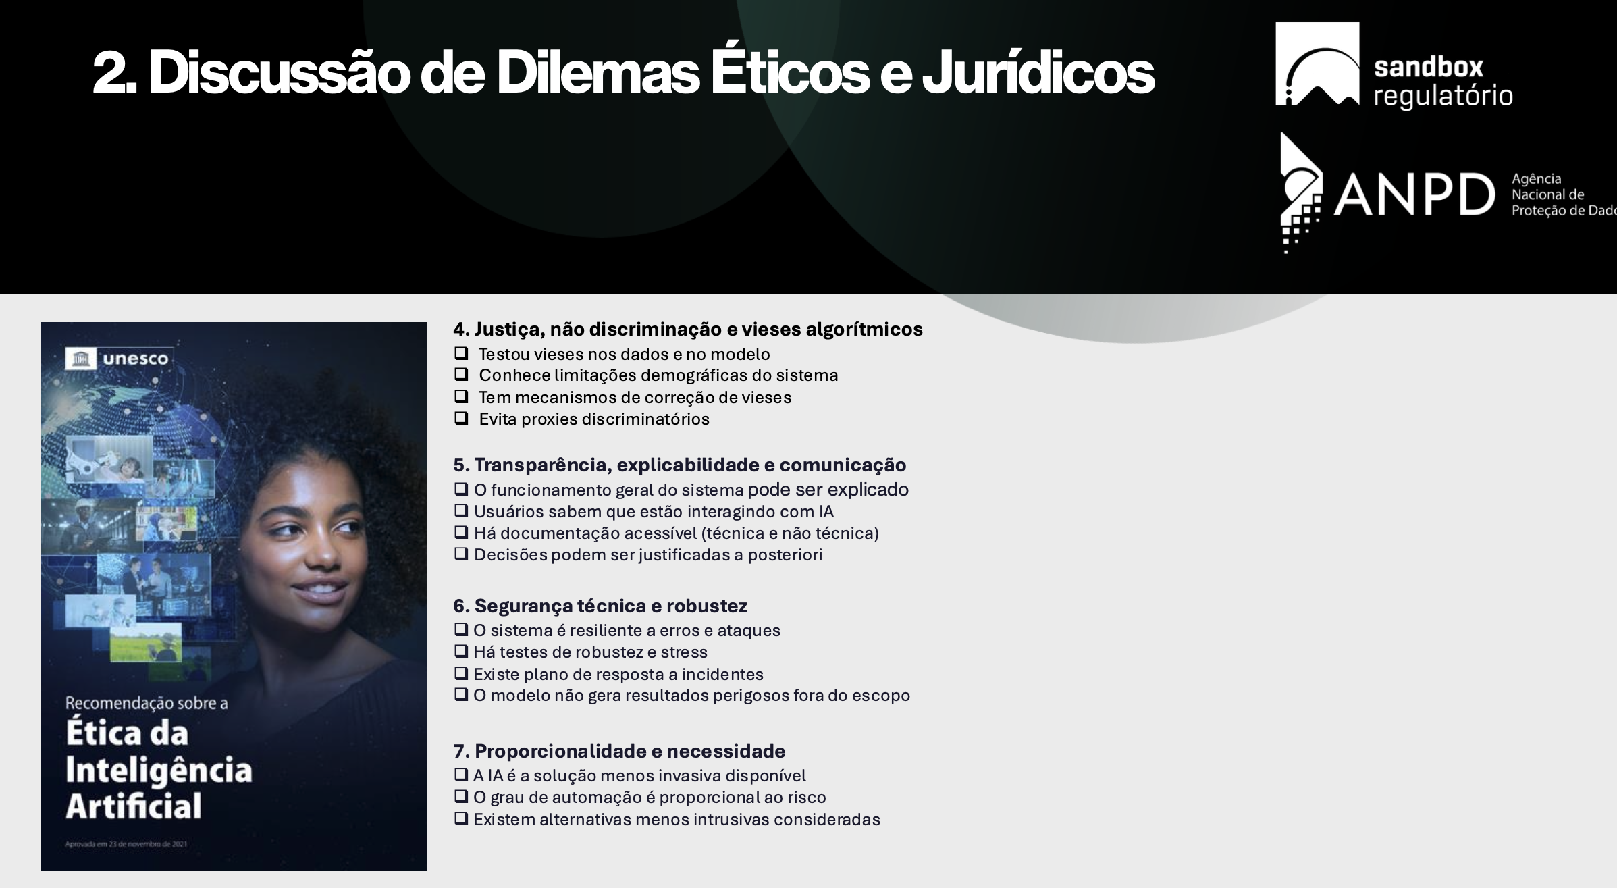
AI Regulatory Sandbox Evaluation for UNESCO EAI
The ultimate output is not simply a score.
It is regulatory learning: what works, what needs mitigation, what should be restricted, and what should not proceed to deployment.

Slide 10
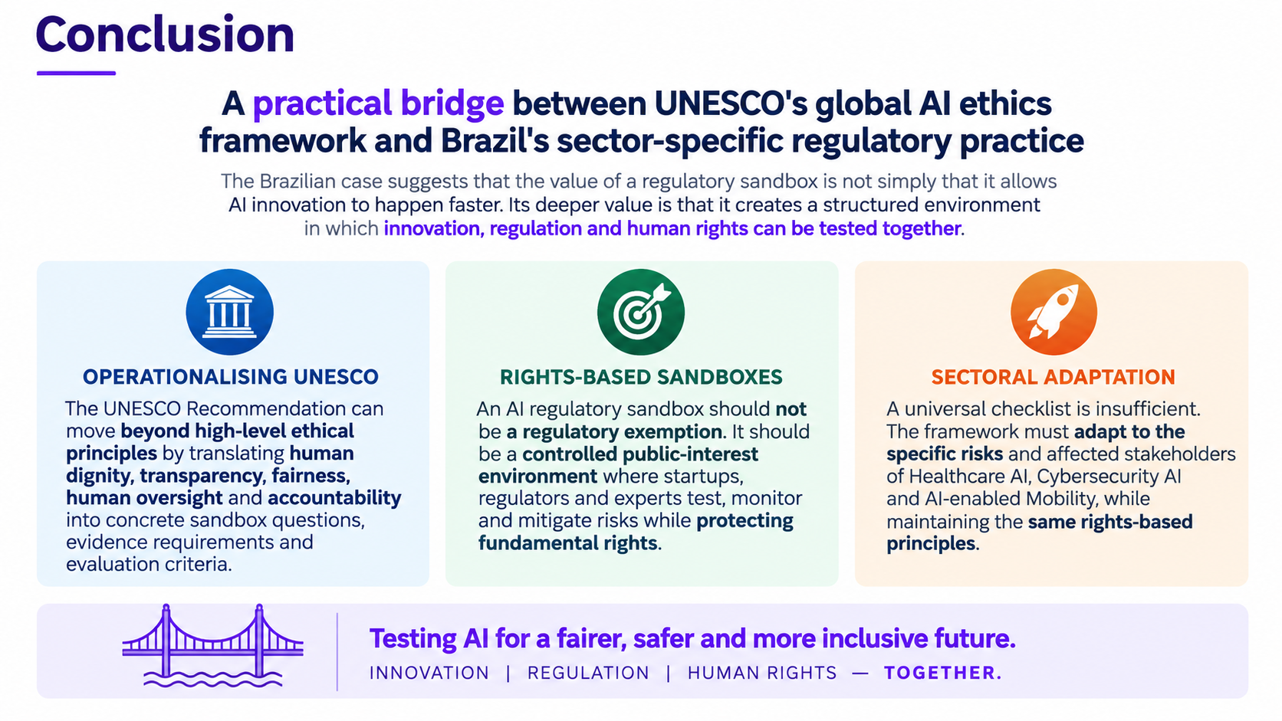
Conclusion
A practical bridge between UNESCO's global AI ethics framework and Brazil's sector-specific regulatory practice
The Brazilian case suggests that the value of a regulatory sandbox is not simply that it allows AI innovation to happen faster. Its deeper value is that it creates a structured environment in which innovation, regulation and human rights can be tested together.
✓
🎯
🚀
OPERATIONALISING UNESCO
RIGHTS-BASED SANDBOXES
SECTORAL ADAPTATION
The UNESCO Recommendation can move beyond high-level ethical principles by translating human dignity, transparency, fairness, human oversight and accountability into concrete sandbox questions, evidence requirements and evaluation criteria
An AI regulatory sandbox should not be a regulatory exemption. It should be a controlled public-interest environment where startups, regulators and experts test, monitor and mitigate risks while protecting fundamental rights
A universal checklist is insufficient. The framework must adapt to the specific risks and affected stakeholders of Healthcare AI, Cybersecurity AI and AI-enabled Mobility, while maintaining the same rights-based principles

Slide 11
Obrigado!
Cristina Godoy de Oliveira | @cristina-godoy-bernardo-de-oliveira

